Slide 1
What Is The Gospel?
A Five-Part Series in TCF
Part Three
“Righteousness as a Gift Through Faith”
By Andy Acreman
10th November 2024

Slide 2
What Is The Gospel? (a 5-part teaching series)
Jeremiah 31:33-34 NIV. “This is the covenant I will make with the people of Israel after that time,” declares the LORD. “I will put my law in their minds and write it on their hearts. I will be their God, and they will be my people. No longer will they teach their neighbour, or say to one another, ‘Know the LORD,’ because they will all know me, from the least of them to the greatest,” declares the LORD. “For I will forgive their wickedness and will remember their sins no more.”
We can see that there are three main kinds of benefit outlined:
    Judicial Innocence
    Inner Christlikeness
    Blessings of a Close Relationship with God

Slide 3
What Is The Gospel? – Topics Covered…
Realistic About Sin – and its consequences!
Recognising Jesus' Death and Resurrection
Righteousness as a Gift Through Faith – judicial innocence
Released from the Power of Sin Over Us – an inner Christlikeness
Received Into God's Family – the blessings of a close relationship

Slide 4
“Recognising Jesus’ Death and Resurrection”
Romans 3:21-25a ESV
But now the righteousness of God has been manifested apart from the law, although the Law and the Prophets bear witness to it - [22] the righteousness of God through faith in Jesus Christ for all who believe. For there is no distinction: [23] for all have sinned and fall short of the glory of God, [24] and are justified by his grace as a gift, through the redemption that is in Christ Jesus, [25] whom God put forward as a propitiation by his blood, to be received by faith...

Slide 5
Points to Cover Today…
What is Righteousness?
What is Justification?
How do we receive these?
Not by Works!
What does Justification ‘fix’?

Slide 6
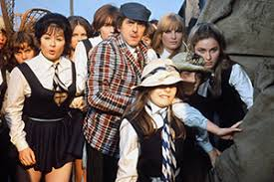
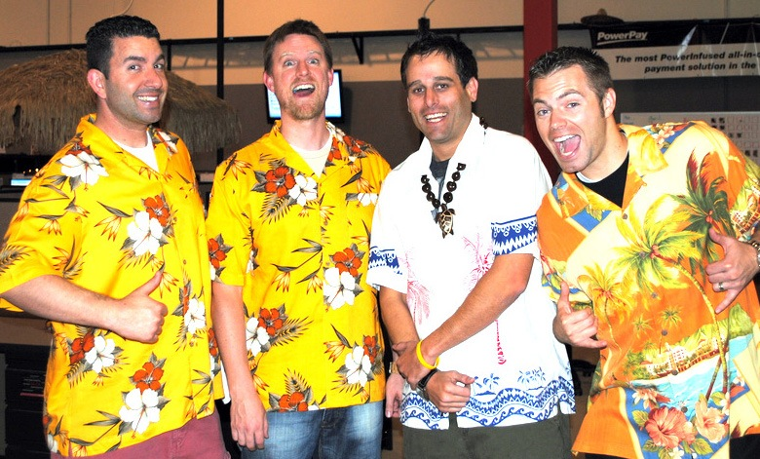
What is Righteousness? - 1

Slide 7
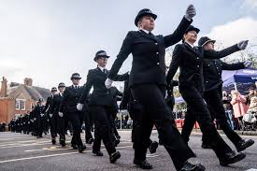
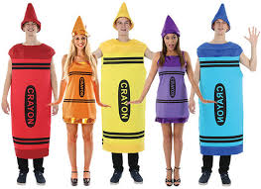
What is Righteousness? - 2

Slide 8
What is Righteousness? - 3
Spiritually, if God accepts us, we are righteous. Isaiah 61:10 NIV. I delight greatly in the LORD; my soul rejoices in my God. For he has clothed me with garments of salvation and arrayed me in a robe of his righteousness, as a bridegroom adorns his head like a priest, and as a bride adorns herself with her jewels.
The first person mentioned in the Bible as being ‘righteous’ is Noah (Genesis 6:9; 7:1). Then Abraham (Genesis 15:6 NIV. “Abram believed God, and he credited it to him as righteousness”). Job was described as ‘blameless’ in Job 1:1. Joseph, in Matthew 1:19 was called a ‘righteous man’. So was Joseph of Arimathea (Luke 23:50). Not forgetting Abel (Hebrews 11:4). Yet none of them was perfect.

Slide 9
What is Righteousness? - 4
Biblically, to be righteous means to be free of sin, fully obedient to God’s Law, and completely submitted to His will. And to be perfect in all aspects. Not a speck or a crease or a stain. Which is a bit of a problem for us!
James 2:10 NIV. For whoever keeps the whole law and yet stumbles at just one point is guilty of breaking all of it.
Are there many people today would themselves qualify as ‘righteous’?
Romans 3:10 NIV. As it is written: "There is no one righteous, not even one…”.

Slide 10
What is Righteousness? - 5
Deuteronomy 6:25 NIV. “…And if we are careful to obey all this law before the LORD our God, as he has commanded us, that will be our righteousness."
Romans 2:13 NIV. “For it is not those who hear the law who are righteous in God's sight, but it is those who obey the law who will be declared righteous”.
Matthew 5:17 NIV. "Do not think that I have come to abolish the Law or the Prophets; I have not come to abolish them but to fulfil them.
Matthew 3:15 NIV. Jesus replied, "Let it be so now; it is proper for us to do this to fulfil all righteousness."

Slide 11
What is Justification?
God declaring that we have been forgiven and have been credited with the Righteousness of Christ.
The Judge acquitting us in court! “Not Guilty!”. Innocent.
E.g. A police officer’s warrant card. Proof of identity, status and authority, a declaration signed by the Chief Constable of the force.
Notice that Justification is a legal event, that took place in the Court of Heaven. It is ‘external’ to us. It doesn’t say how good we are inside, or how hard we have worked, it just says that God has decreed us to be acceptable to Him.

Slide 12
How Do We Receive Justification? - 1
Romans 3:21-25a ESV
But now the righteousness of God has been manifested apart from the law, although the Law and the Prophets bear witness to it - [22] the righteousness of God through faith in Jesus Christ for all who believe. For there is no distinction: [23] for all have sinned and fall short of the glory of God, [24] and are justified by his grace as a gift, through the redemption that is in Christ Jesus, [25] whom God put forward as a propitiation by his blood, to be received by faith...

Slide 13
How Do We Receive Justification? - 2
2 Corinthians 5:21 NIV.
God made him who had no sin to be sin for us, so that in him we might become the righteousness of God.
Romans 4:3-5 NIV.
What does Scripture say? "Abraham believed God, and it was credited to him as righteousness." [4] Now to the one who works, wages are not credited as a gift but as an obligation. [5] However, to the one who does not work but trusts God who justifies the ungodly, their faith is credited as righteousness.

Slide 14
Not By Works! - 1
Romans 3:21,28 NIV. But now apart from the law the righteousness of God has been made known, to which the Law and the Prophets testify… [28] For we maintain that a person is justified by faith apart from the works of the law.
Galatians 2:16b,21 NIV. …[We] know that a person is not justified by the works of the law, but by faith in Jesus Christ. So we, too, have put our faith in Christ Jesus that we may be justified by faith in Christ and not by the works of the law, because by the works of the law no one will be justified… [21] I do not set aside the grace of God, for if righteousness could be gained through the law, Christ died for nothing!"

Slide 15
Not By Works! - 2
Ephesians 2:8-9 NIV. For it is by grace you have been saved, through faith - and this is not from yourselves, it is the gift of God - not by works, so that no one can boast.
Important to notice that we cannot even claim credit for our faith. This also is a gift from God (see also 1 Peter 1:21; Philippians 1:29; 1 Corinthians 1:30; Acts 13:48). Otherwise, our faith would be just another kind of ‘work’ that we could boast about. Faith is simply God’s instrument to credit us with His righteousness. It’s really all about grace!

Slide 16
What Does Justification ‘Fix’? - 1
Romans 8:1 NIV. Therefore, there is now no condemnation for those who are in Christ Jesus…
Romans 5:1… Having been justified by faith… Aorist tense (past completed, done once and for ever). You only need to be justified once – it lasts for eternity!
Revelation 12:10b-11a NIV. …For the accuser of our brothers and sisters, who accuses them before our God day and night, has been hurled down. [11] They triumphed over him by the blood of the Lamb and by the word of their testimony…

Slide 17
What Does Justification ‘Fix’? - 2
Romans 5:1-2 NIV. Therefore, since we have been justified through faith, we have peace with God through our Lord Jesus Christ, [2] through whom we have gained access by faith into this grace in which we now stand. And we boast in the hope of the glory of God.
We were once God’s enemies; we were ‘at war’ with Him. Now, however, we are ‘at peace’ and on the same side. Do we actually believe this?
Notice it is ‘Peace with God’, not ‘The Peace of God’ (which transcends all understanding – Philippians 4:7) that it refers to here. Can’t have the second without the first, though.

Slide 18
What Does Justification ‘Fix’? - 3
Hebrews 10:19-22 NIV. Therefore, brothers and sisters, since we have confidence to enter the Most Holy Place by the blood of Jesus, [20] by a new and living way opened for us through the curtain, that is, his body, [21] and since we have a great priest over the house of God, [22] let us draw near to God with a sincere heart and with the full assurance that faith brings, having our hearts sprinkled to cleanse us from a guilty conscience and having our bodies washed with pure water.
Do we have that full assurance inside us that we are saved? Genuine faith brings this to our spirits.

Slide 19
What Does Justification ‘Fix’? - 4
Hebrews 2:14-15 NIV. Since the children have flesh and blood, he too shared in their humanity so that by his death he might break the power of him who holds the power of death-that is, the devil- [15] and free those who all their lives were held in slavery by their fear of death.
We may not relish the process of dying, but we should now have lost our fear of death itself – since our loving Saviour and Lord will be there to greet us.

Slide 20
What Does Justification ‘Fix’? - 5
[22] let us draw near to God with a sincere heart and with the full assurance that faith brings, having our hearts sprinkled to cleanse us from a guilty conscience and having our bodies washed with pure water.
Our consciences are not perfect, and often a ‘weak’ conscience will be self-condemnatory and harsh with us. But justification nevertheless cleanses us from any guilt for past or present sins.

Slide 21
In Summary…
Righteousness is being completely acceptable to God
Justification is where God declares you to be Righteous
We receive these by GRACE through FAITH
Never by good works / obeying the Law – impossible!
Justification ‘fixes’…
  Condemnation / accusation / punishment
  War with God; - Fear of Death;
  Doubt about our destiny - Guilty Conscience

